Slide 1
Flip-flops

Slide 2
outline
W-5: Flip-Flops (FF): NAND gate latch, NOR gate latch, D latch**,
clock signals and clocked FFs, clocked S-C FF.
W-6: Clocked J-K FF, Clocked D FF, Master-slave FF and so on.

Slide 3
Digital pulses

Slide 4
Introduction
When a signal switches from a normal inactive state to the opposite (active) state, thus causing something to happen in the circuit. Then the signal returns to its inactive state while the effect of the recently activated signal remains in the system. These signals are called pulses. Two terms need to understand: pulses and pulse waveforms.

Slide 5
Digital Pulses
A pulse that performs its intended function when it goes HIGH is called positive pulse, and a pulse that performs its intended function when it goes LOW is called a negative pulse.
In actual circuits it takes time for a pulse waveform to change from one level to the other. These transition times are called the rise time (t_{r}) and the fall time (t_{f}) and are defined as the time it takes the voltage to change between 10% and 90% of the HIGH level voltage as shown on the positive pulse in the following figure. The transition at the beginning of the pulse is called the leading edge and the transition at the end of the pulse is called the trailing edge. The duration (pulse width) of the pulse is defined as the time between the points when the leading and trailing edges are at 50% of the HIGH level voltage.

Slide 6
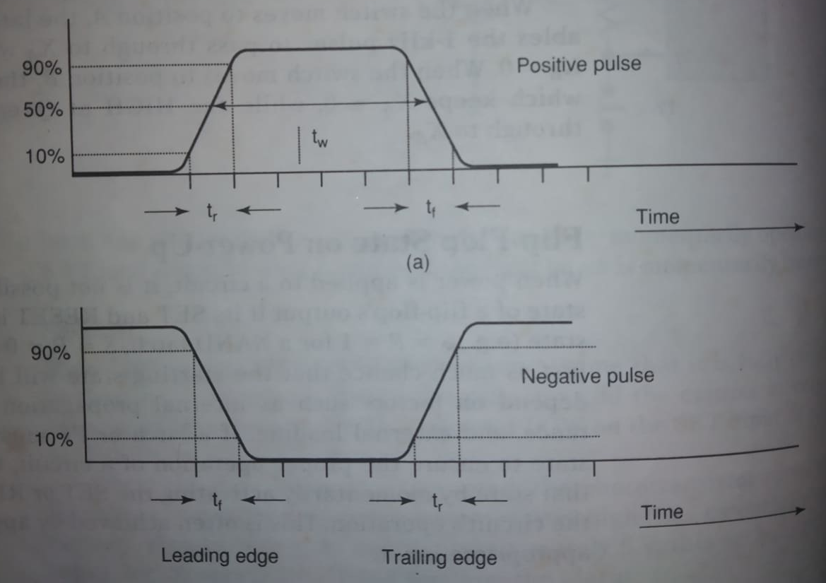
Digital pulses (positive/Negative pulse)

Slide 7
Clock signal

Slide 8
Clock signal
Digital system can operate either asynchronously or synchronously. In asynchronous system, the outputs of logic circuits can change state any time one or more of the inputs change.
In synchronous system, the exact times at which any output can change states are determines by a signal commonly called the clock. System outputs can change state only when the clock makes a transition. When the clock changes from 0 to 1 this is called positive-going transition (PGT) otherwise it is called negative-going transition (NGT).

Slide 9
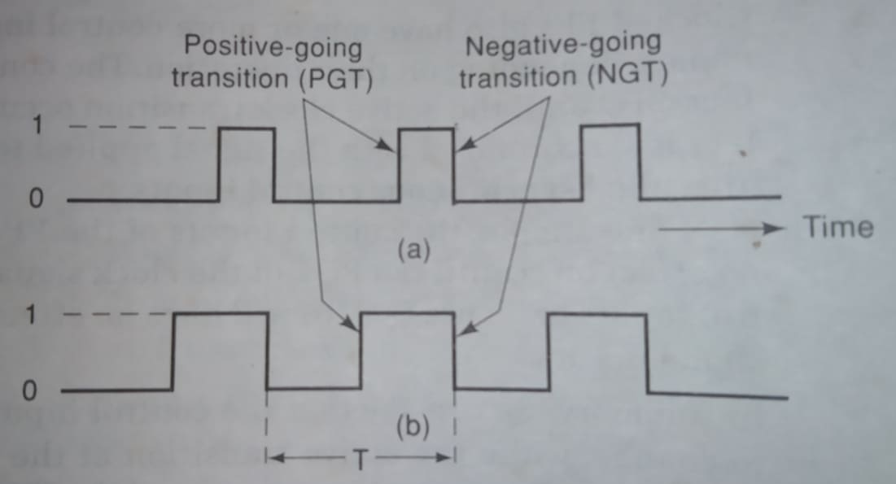
Clock signal

Slide 10
Clock signal
A clock signal is measured from one PGT to the next PGT or from one NGT to the next NGT. The time it takes to complete one cycle is called period (T). The speed of the digital system is normally referred to by the number of clock cycles that happen in 1 second (cycles/second) which is known as the frequency (f) of the clock. Standard unit for frequency is Hertz. 1 Hz= 1 cycle/second.

Slide 11
Clocked FFs

Slide 12
Clocked FFs
The principal ideas that are common to all of the clocked FFs are-
Clocked FFs have a clock input that is typically labeled CLK/CK/CP. In most clocked FFs, the CLK input is edge-triggered, which means that it is activated by a signal transition, indicated by the presence of small triangle (arrow) on the CLK input. This contrasts with the latches, which are level-triggered.
Clocked FFs also have one or more control inputs that can have various names, depending on their operation. The control inputs will have no effect on Q until the active clock transition occurs. Or their effect is synchronized with the signal applied to CLK. For this reason they are called synchronous control inputs.

Slide 13
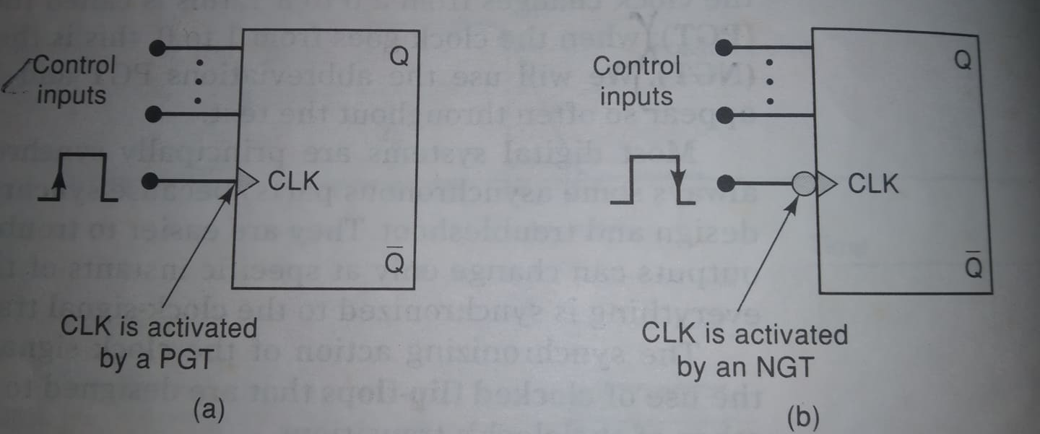
Clocked FFs

Slide 14
Clocked FFs
Summary:
The control inputs control the WHAT ( what state the output will go to).
The CLK input determines the WHEN.

Slide 15
Clocked S-R (/S-C) FF

Slide 16
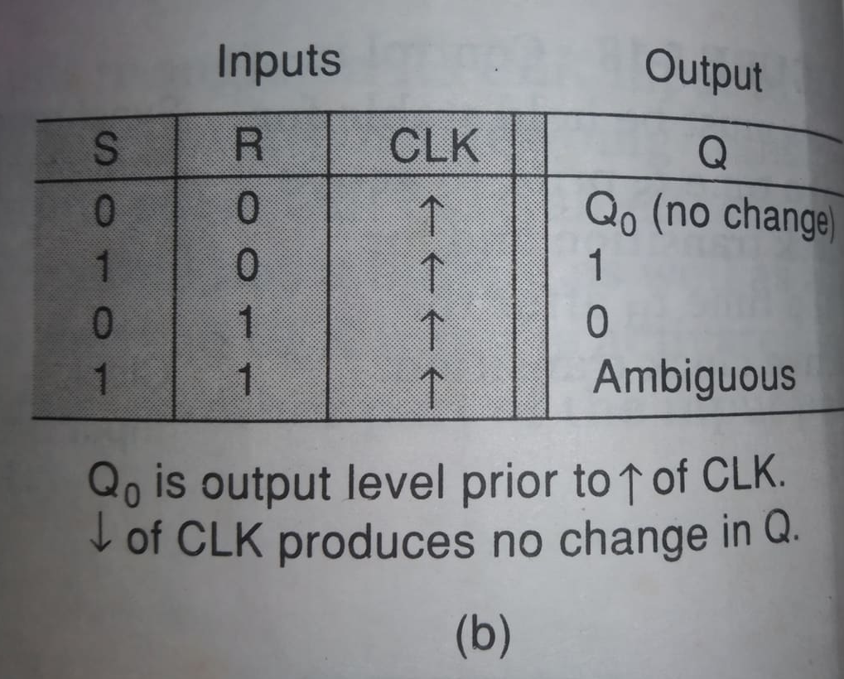
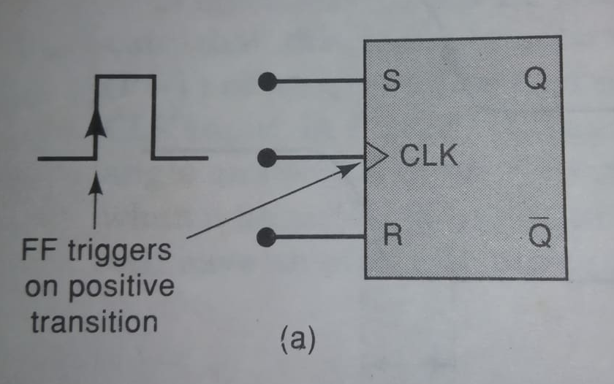
Clocked S-R (/S-C) FF

Slide 17
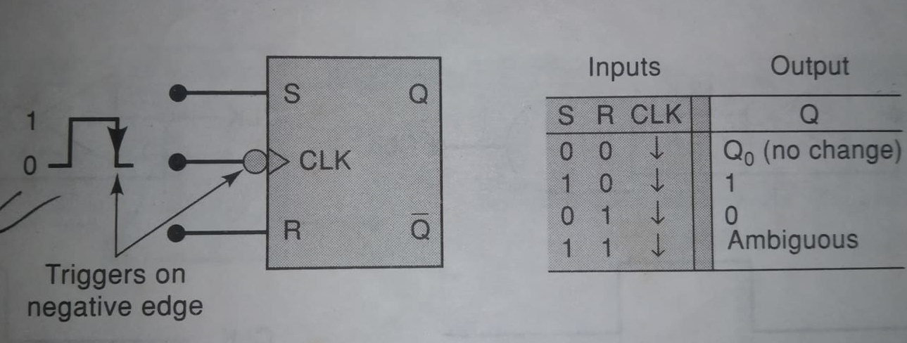
Clocked S-R (/S-C) FF

Slide 18
Clocked S-R (/S-C) FF
The S and R inputs control the state of the FF in the same manner as described earlier for the NOR gate latch. But the FF does not respond to these inputs until the occurrence of the PGT (/NGT) of the clock signal.

Slide 19
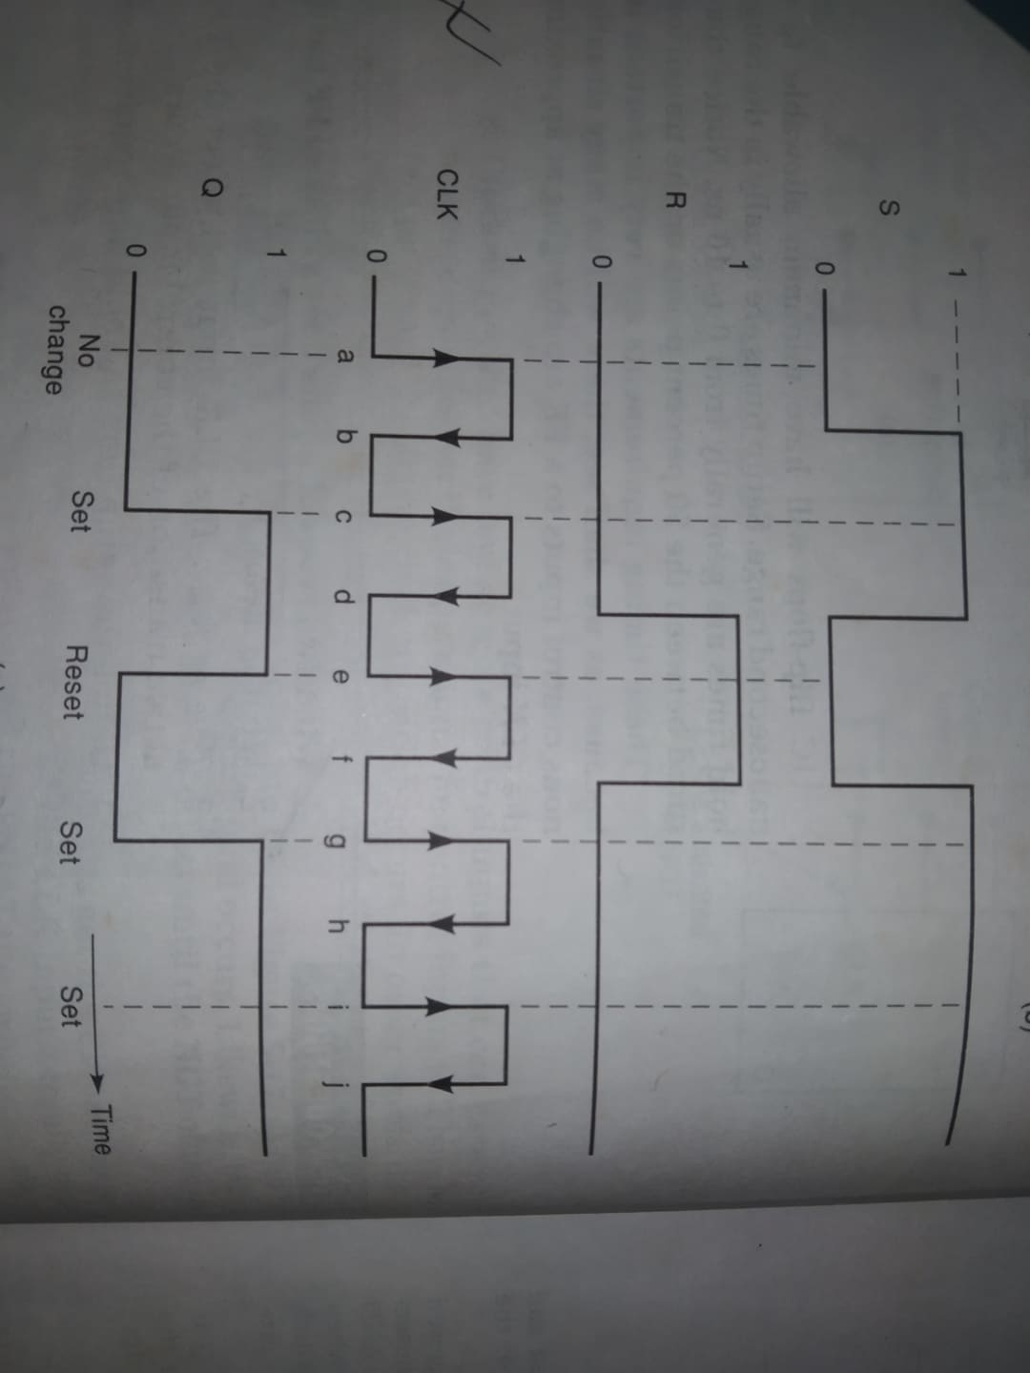
Clocked S-R (/S-C) FF

Slide 20
Clocked S-R (/S-C) FF
Procedure/ Explanation:
Initially all inputs are 0, Q is assumed to be 0.
For the PGT of the first clock pulse, output remains Q=0 [(no change)=> NOR latch].
For the PGT of 2nd clock pulse, S=1, R=0; FF is now in setting state. That’s why Q=1.
For the 3rd clock pulse, S=0, R=1; FF is now in clearing state. That’s why Q=0.
For the 4th and 5th clock pulses it will show the behavior of no. 3.

Slide 21
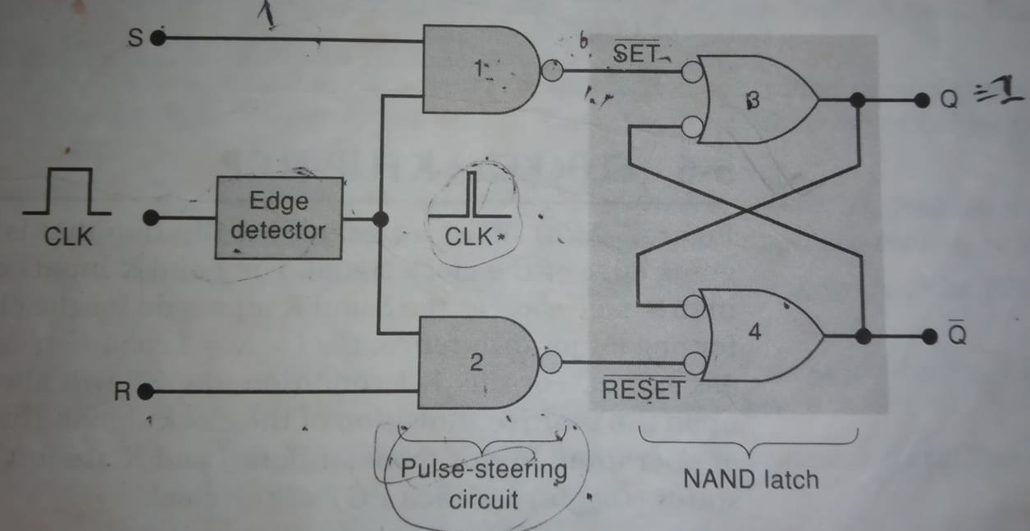
Internal Circuitry of Edge triggered S-R (/S-C) FF For PGT

Slide 22
Internal Circuitry of Edge triggered S-R (/S-C) FF
Three sections are-
Basic NAND gate latch formed by NAND-3 and NAND-4.
A pulse-steering circuit formed by NAND-1 and NAND-2.
An edge detector circuit.

Slide 23

Internal Circuitry of Edge triggered S-R (/S-C) FF
Edge detector: It produces a narrow positive going spike. The inverter produces a delay of a few nano-seconds. So that the transition of $\overline{CLK}$ occur a little bit after those of CLK. The AND gate produces an output spike that is HIGH only for the few nano-seconds CLK and $\overline{CLK}$ are both HIGH. The result is a narrow pulse at CLK*, which occurs on the PGT of CLK.
The arrangement is little different to produce NGT of CLK.

Slide 24
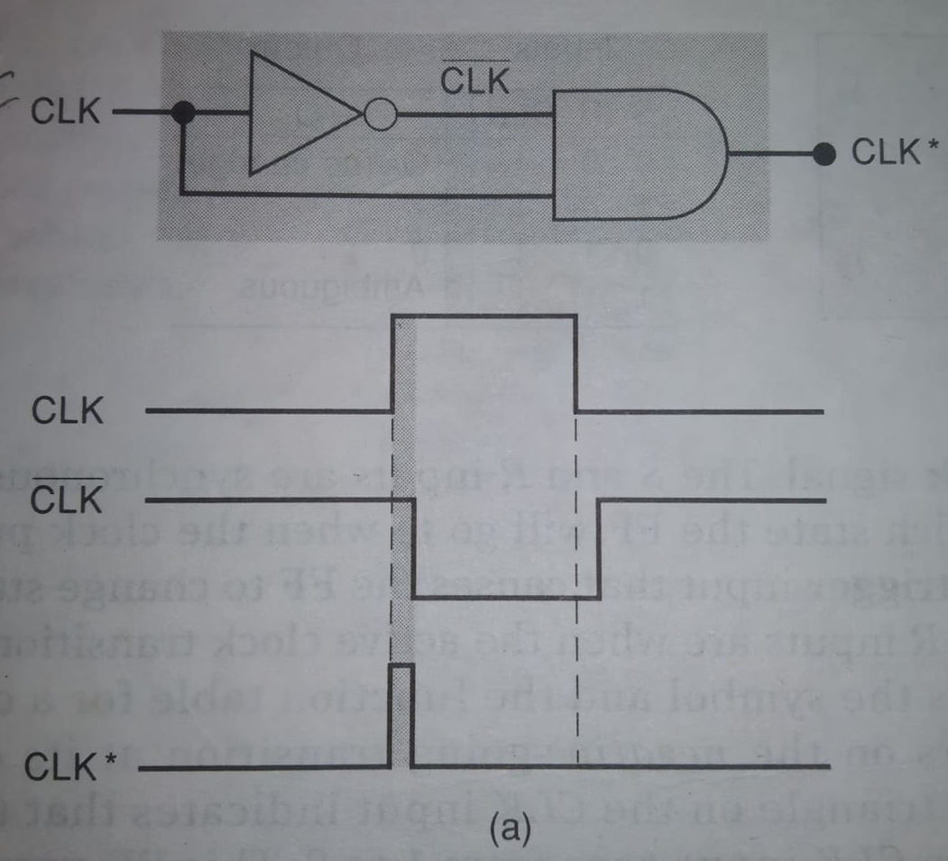
Edge Detector

Slide 25
Internal Circuitry of Edge triggered S-R (/S-C) FF
Pulse steering circuit: It steers the spike through to the S or R input of the latch (input of NAND latch) in accordance with the levels present at S and R (input of S-R FF).
For S=1, R=0 (input of S-R FF), pulse steering circuit send the CLK* signal to NAND 1to produce a LOW pulse at the SET input of the NAND latch that sets Q=1.
For S=0, R=1(input of S-R FF), CLK* signal to NAND 2 to produce a LOW pulse at the RESET input of the NAND latch that reset Q=0.

Slide 26
Clocked S-R (/S-C) FF

Slide 27
Clocked J-K FF

Slide 28
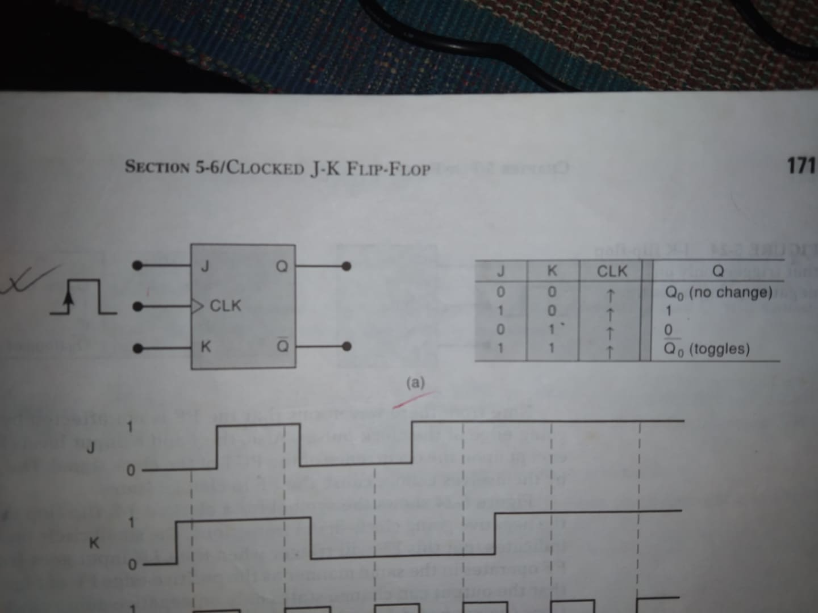
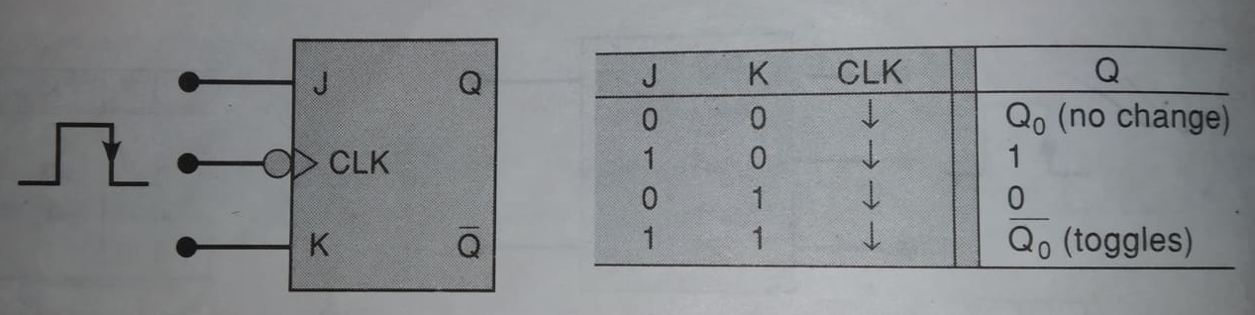
Clocked J-K FF

Slide 29
Clocked J-K FF
Clocked J-K FF that is triggered by the PGT of the clock. J and K inputs control the state of the FF in the same ways as the s, R inputs do for the clocked S-R FF except J=K=1. It does not produce ambiguous output. In this condition FF will always go to its opposite state upon the PGT.
The J-K FF is much more versatile than the S-R FF because it has no ambiguous state. Toggle operation is extensively used in all types of binary counters.

Slide 30
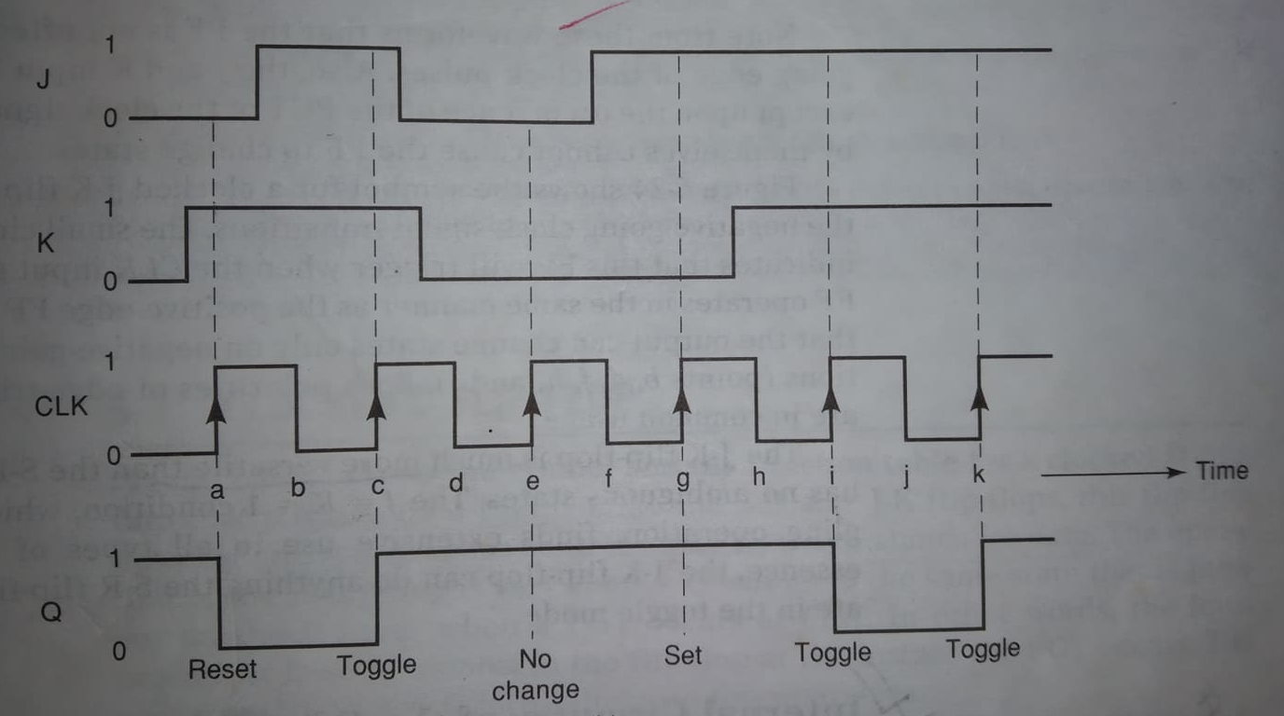
Clocked J-K FF

Slide 31
Clocked J-K FF
Procedure/ Explanation:
Initially all inputs are 0, Q is assumed to be 1.
For the PGT of the first clock pulse, J=0, K=1 thus the FF will be reset to the Q=0 state.
For the PGT of 2nd clock pulse, J=K=1. This causes the FF to toggle to its opposite state Q=1.
For the 3rd clock pulse, J=K=0; FF does not change state; Q=1.
For the 4th clock pulse, J=1, K=0; this condition sets the Q=1. However, it is already 1, and so it will remain there.
For the 5th clock pulse J=K=1, so the FF toggles to its opposite state.

Slide 32
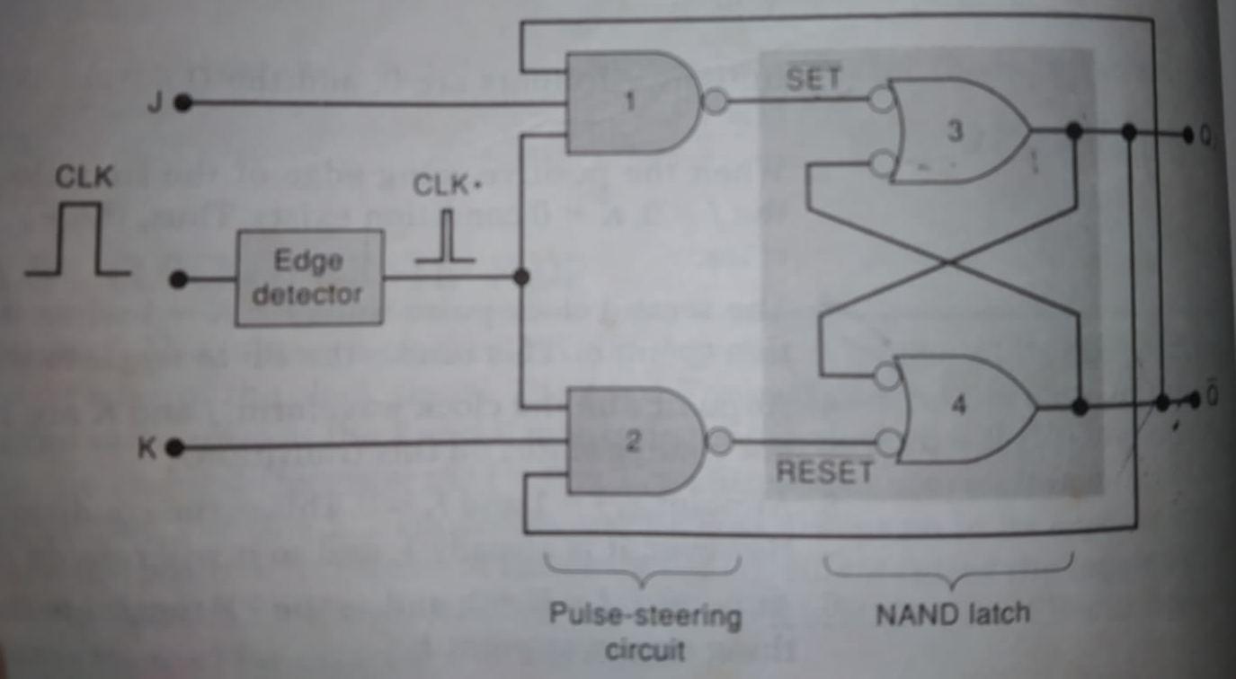
Internal Circuitry of Edge triggered J-K FF

Slide 33

Internal Circuitry of Edge triggered J-K FF
Three sections are-
Basic NAND gate latch formed by NAND-3 and NAND-4.
A pulse-steering circuit formed by NAND-1 and NAND-2.
An edge detector circuit.
Only difference between S-R and J-K FF circuits is that $Q and \overline{Q}$ outputs are fed back to the pulse steering NAND gates. This feedback connection gives the J-K FF to its toggle mode of operation for J=K=1.

Slide 34

Internal Circuitry of Edge triggered J-K FF
Assume, J=K=1 where Q=0 $and \overline{Q}=1$. For the clock pulse, steering circuit send the clock through NAND gate 1. The active low output ($\overline{SET}$ input) produce the NAND latch output Q=1.
Note that q is fed back to NAND 2 input. That means, K=1, feedback input is 1 also. Then the steering circuit send the clock to NAND 2 which is also 1. The active low output ($\overline{RESET}$ input) produce the NAND latch output Q=0. Thus Q always end up in the opposite state.

Slide 35
Clocked D FF

Slide 36
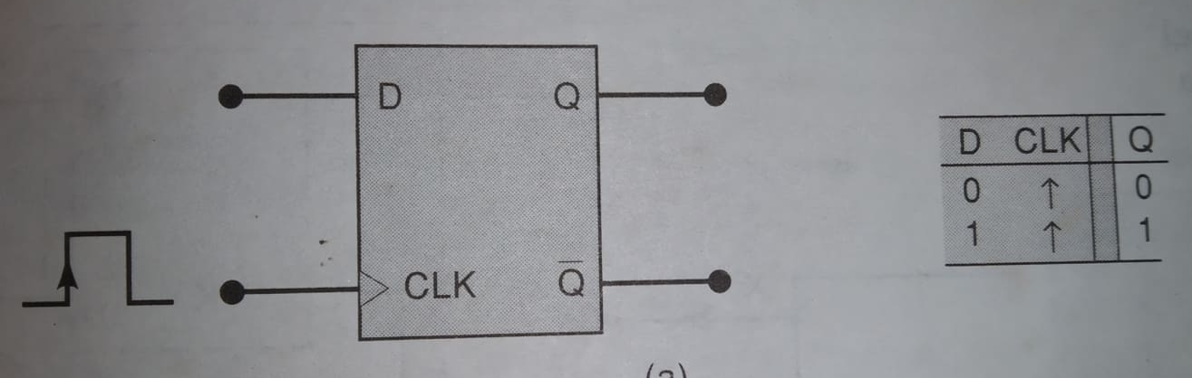
Clocked D FF

Slide 37
Clocked D FF
Unlike the Clocked S-R and J-K FFs, this FF has only one synchronous control input D, which stands for data. Operation is very simple. Q will go to the same state that is present on the D input when a PGT occurs. In other words the level present at D will be stored in the FF at the instant the PGT occurs.

Slide 38
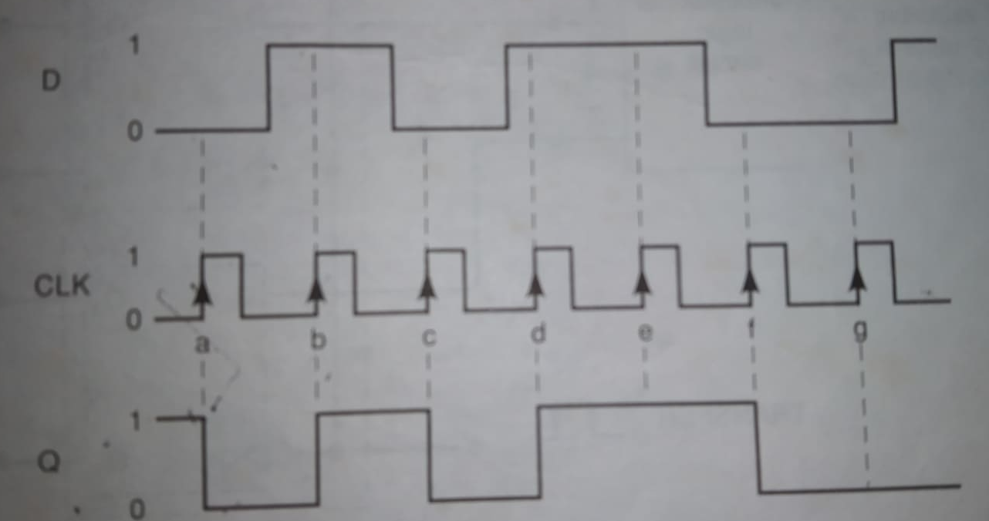
Clocked D FF

Slide 39
Clocked D FF
Procedure/ Explanation:
Assume, initially Q=1.
For the PGT of the first clock pulse, D input is LOW, thus Q will go to 0 state. Even though the D input level changes between point a and b , it has no effect on Q.
For the PGT of 2nd clock pulse, Q goes HIGH because D is HIGH at that time.
In a similar manner, the Q output takes on the levels present at D when the PGTs occur at points c, d, e, f and g.

Slide 40
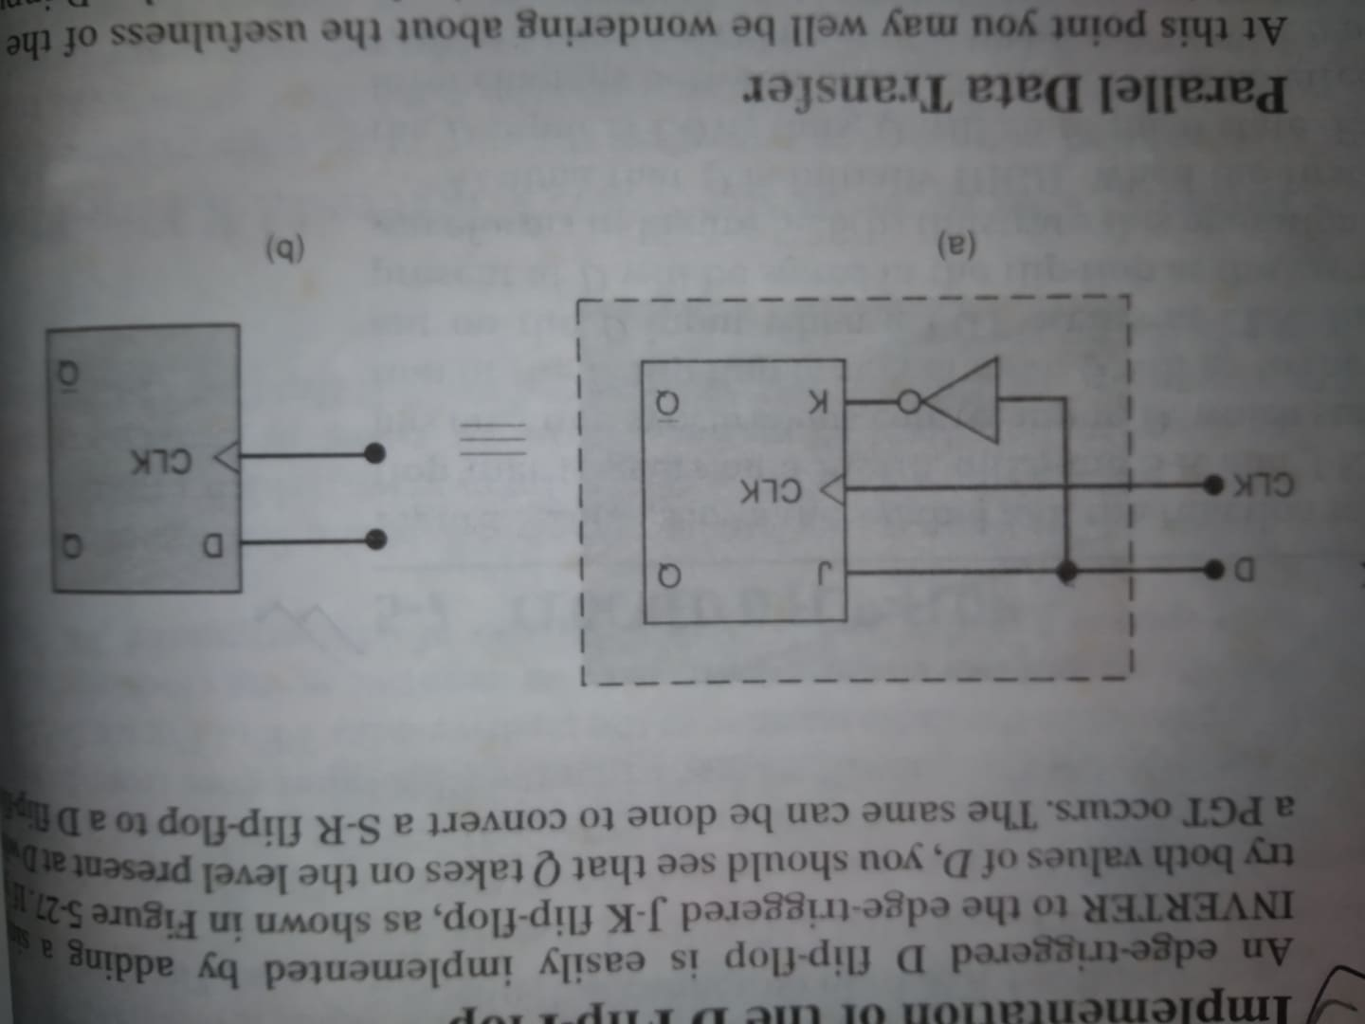
Implementation of D FF

